Slide 1

KAVAYITRI BAHINABAI CHAUDHARI NORTH MAHARASHTRA UNIVERSITY, JALGAON
For fulfillment of requirements for the award of degree of pharmacy
( B. Pharm.)
Analytical Method Development and Validation of Mirabegron By Using Rp-HPLC Method of Bulk and Pharmaceutical Dosage Form.
SUBMITTED BY:
Mr.Yash Shantaram Wagh
(PRN No- 2022015400389912)
GUIDED BY:
Mrs. Neha A. Porwar
Asso. Prof.

Slide 2
CONTENTS
Introduction
Objective
Drug Profile
Experimental work
Result
Summary
Conclusion
Reference

Slide 3
INTRODUCTION
Analytical chemistry is a science and art of recognized the various substance use in specify matrix and determination of its constitute.
Analytical chemistry is derived in two parts:
Qualitative analysis
Quantitative analysis
Chromatography:
A method of separating a mixture of components into individual components through equilibrium distribution between two phases that is mobile phase and stationary phase.
There are two types of chromatography:
Adsorption Chromatography
Partition Chromatography

Slide 4
High Liquid Performance Chromatography:
HPLC is an advanced form of chromatography.
It has mobile phase and stationary phase.
A sample mixture in a solvent(mobile phase) is pumped at high pressure through a column with packing material(stationary phase).
Advantages:
High accuracy
High reproducibility
Fast analysis
Applications:
Widely used for drug analysis and drug separation.
Separates compounds based on polarity and interactions.

Slide 5
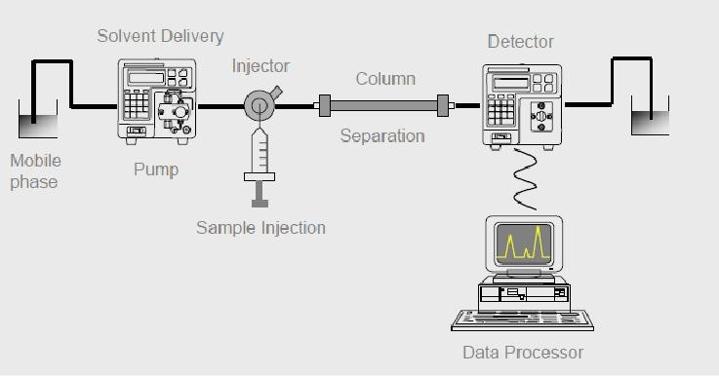
Instrumentation:
Solvent reservoir and Treatment system
Following are the components in HPLC:
Mobile phase
Pump system
Sample Injection System
Column
Detector
Diagram of HPLC

Slide 6
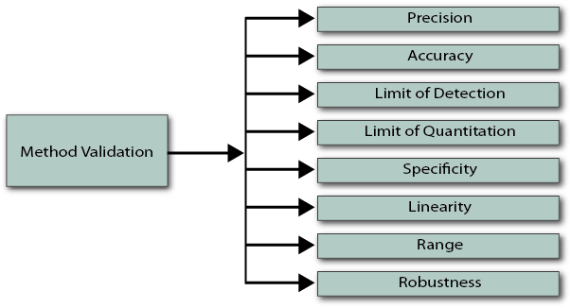
Validation:
Assures that the method works reproducibly.
To understand parameters in the process.
ICH Guidelines.
Methods of validation

Slide 7
OBJECTIVES
The objectives of this dissertation work areas follows:
To develop simple, rapid and sensitive, stable and highly effective simple RP-HPLC method for determination of Mirabegron.
To validate methods as per ICH Guidelines.
To analyse Mirabegron using validated methods quantitatively and qualitatively.

Slide 8
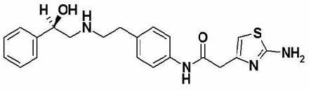
DRUG PROFILE
Drug: Mirabegron
Brand name: Miraben ER-25
Structure:
Structure of mirabegron
Molecular Formula: C₁₈H₂₂N₂O₂
Molecular Wt.: 298.4 g/mol
Category: Beta-3 adrenergic receptor
Use: To treat Overactive bladder (OAB)

Slide 9
EXPERIMENTAL WORK
HPLC was selected as analytical technique for estimation of Mirabegron.
Trail and error method was used for the selection of chromatographic conditions.
Sr no. | Parameters | Description
1. | HPLC | Agilent Tech. Gradient System With Auto injector, UV Detector
2. | Software | Chemstation 10.1
3. | Column | (Agilent) C18 column (4.6 x 150mm)
4. | Particle size | 5µm
5. | Stationary phase | C-18 (Agilent)
6. | Mobile phase | Methanol:0.1% OPA (55:45)
7. | Detection wavelength | 254nm
8. | Flow rate | 0.7 ml/min
9. | Temperature | Ambient
10. | Sample size | 20µl
11. | Ph | 3

Slide 10
Sr no. | Parameters | Description
12. | Run time | 15 min
13. | Filter paper | 0.45µ
UV-VIS Spectrophotometer:
UV-VIS Spectrophotometer was selected for estimation.
UV Visible absorbance range of 200-400nm.
The instrument needs about 1 minute for initialization.
Light Source used:
Deuterium lamp
Cuvette used:
Quartz cuvette

Slide 11
Preparation of Stock Standard Solution:
Standard Solution Stock I : (Mirabegron)
Accurately weigh and transfer 5 mg Mirabegron working standard into 10 ml volumetric flask as about diluents Methanol completely and make volume up to the mark with the same solvent to get 500 µg/ml standard (stock solution) and 15 min sonicate to dissolve it and the resulting stock solution 0.1ml was transferred to 10 ml volumetric flask and the volume was made up to the mark with mobile phase Methanol: (0.1%OPA)Water, prepared in (5.5 ml MEOH: 4.5 ml (0.1%OPA)Water v/v)solvent .
Validation method:
ICH Guidelines were used for the method validation guidelines Q2 (R1).

Slide 12
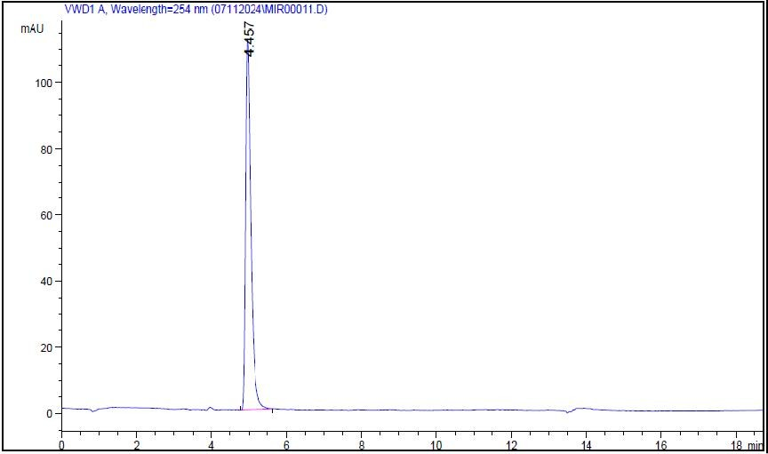
RESULT AND DISCUSSION
Preliminary studies on Mirabegron were done.
Melting point
Appearance
Solubilty
Studies on the chromatographic behavior of Mirabegron:
After the selection of suitable mobile phase, it was then optimized for its reproducibility, sensitivity & accuracy.
Wavelength curve of mirabegron

Slide 13
RT | Area | TP | TF | Resolution
4.469 | 368.5 | 7846 | 0.62 | -
Chromatography curve of Final trail
Analytical of Method Validation:
Linearity:
From Mirabegron standard stock solution different working standard solution (5-25 μg/ml) were prepared in mobile phase 20 μl of sample solution was injected into the chromatographic system using mixed volume loop injector. Chromatograms were recorded.

Slide 14
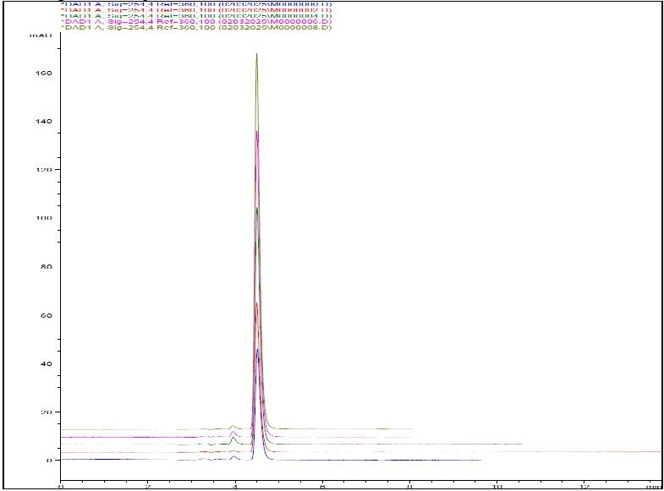
Sr no. | Conc | Area MBG
1. | 5 | 368.09
2. | 10 | 597.48
3. | 15 | 789.30
4. | 20 | 1028.49
5. | 25 | 1268.83
Result of linearity of chromatography
Overlay of linearity(5-25mcg)
MIRABEGRON
y=44.65x+142.4
R²=0.999
1400.00
1200.00
1000.00
800.00
600.00
400.00
200.00
0.00
Regression equation data Y=mx+c
Slope(m) | 44.65
Intercept(c) | 142.4
Correlation Coefficient | 0.999
Series1
Linear(Series1)
0 10 20 30
conc
Calibration curve of MBG

Slide 15
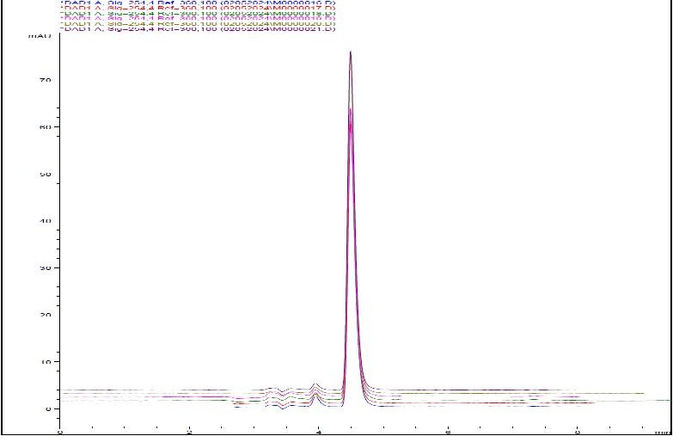
2. Accuracy:
To pre-analyzed Tablet solution, a definite concentration of standard drug (80%, 100%, and 120%) was added and then its recovery was analyzed
Sr no. | Level (%) | Amt. taken | Amt. added | Area mean *±S.D | Amt recovered mean*±S.D | % Recovery mean* ± S.D
1. | 80% | 5 | 4 | 8.98±0.05 | 3.9±0.051 | 99.59±1.28
2. | 100% | 5 | 5 | 9.97±0.030 | 4.97±0.030 | 99.45 ± 0.60
3. | 120% | 5 | 6 | 11.0±0.078 | 6.03±0.078 | 100.5 ±1.31
Result of recovery data for MBG
Overlay of Accuracy(5-25mcg)
Accuracy of method by recovery studies was found to be between 98-102%

Slide 16
3. Repeatability:
To ascertain the resolution and reproducibility of the proposed chromatographic system for estimation of Mirabegron system suitability parameters were studied.
Sr no | Conc. of MBG(mg/ml) | Peak area | Amt. found(mg) | % Amt. found
1. | 15 | 800.87 | 800.77 | 98.30
2. | 15 | 800.66
3. | 15 | 801.868
 |  | Mean | 14.75 | 100.32
 |  | SD | 0.15 | 0.15
 |  | %RSD | 0.02 | 0.02
Repeatability studies of Mirabegron was found to be 98.30 ,The % RSD was less than 2, which shows high percentage amount found in between 98% to 102% indicates the analytical method that concluded .

Slide 17
4. Precision:
All the solution was analyzed thrice in order to record any intra-day & inter-day variation in the result that concluded.
Conc. (µg/ml) | Intra-day precision |  |  | Inter-day precision
 | Mean±SD | %Amt Found | %RSD | Mean±SD | Mean±SD | %RSD
10 | 597.17± 0.03 | 101.85 | 0.00 | 595.88 ±1.08 | 101.56 | 0.18
15 | 798.73± 0.06 | 98.00 | 0.06 | 804.94 ±1.44 | 98.92 | 0.18
20 | 1029.33 ±0.18 | 99.32 | 0.18 | 1032.44± 1.44 | 99.67 | 0.18
Intraday and Interday Precision for Mirabegron which shows the high precision % amount in between 98% to 102% indicates to analytical method that concluded.
5. Robustness:
To evaluate it small but deliberate variations in the optimizsed methods parameters where done. The effect of changes in mobile phase composition and flow rate, wavelength on retention time and tailing factor of drug peak was seen.

Slide 18
Parameters | Conc. (µg/ml) | Amt. detected | %RSD
Mobile phase 54ml+46ml | 15 | 801.68 ± 0.98 | 0.12
Mobile phase 55ml+45ml | 15 | 803.7±2.02 | 0.25
253 nm | 15 | 747.5±1.44 | 0.19
254 nm | 15 | 864.89±1.70 | 0.20
Flow rate 0.6ml | 15 | 940.23±1.20 | 0.13
Flow rate 0.8ml | 15 | 702.79±3.46 | 0.49
The changes were done flow rate (±1 ml/ min⁻¹), PH of mobile phase composition, and Wavelength. %RSD for peak area was calculated which should be less than 2%.the result shown in analytical method that concluded.
6. Limit of Detection:
Lowest limit that can be detected.
LOD of MBG was found to be 0.0572(µg/ml)

Slide 19
7. Limit of Quantification:
Lowest concentration that can be quantitatively measured.
LOD of MBG was found to be 0.1735 (μg/mL)
Analysis of Tablet formulation:
Weigh 20 Mirabegron Tablet and calculate the average weight, accurately weigh and transfer the sample equivalent to 16.89 mg Mirabegron into 10 ml volumetric flask. Add about 10 ml of diluents and sonicate to dissolve it completely and make volume up to the mark with diluent. Mix well and filter through 0.45 µm filter. Further pipette 0.4 ml of the above stock solution into a 10 ml volumetric flask and dilute up to the mark with diluents. (20 µg/ml). The simple chromatogram of test Mirabegron was done and the amounts of Mirabegron per Tablet were calculated by extrapolating the value of area from the calibration curve.

Slide 20
Brand Name Mirabegron ER-25(Prevego Health Care)
Total weight of 20 tablets= 16.89 gms
Avg. powder wt.= 0.8445 gm/ tab
Eq. wt. for 5 mg= 16.89 mg
Take 16.89 mgs in 10 ml methanol = 500 µgm/ml
Sample | Lable claim | % Lable claimed ± SD | % RSD
Mirabegron | 25 mg | 99.41±0.071 | 0.072
%Lable claim
Tablet Assay for % Lable claim for was also was found to be 99.80%and %RSD are less than 2 satisfactory result was concluded.

Slide 21
9. Ruggedness:
Analyst | RT | Area | Therotical plates | Symmetry
1. | 4.455 | 593.101 | 7818 | 0.69
2. | 4.460 | 594.11 | 7649 | 0.62
Analysis of Ruggedness

Slide 22
SUMMARY
Mirabegron is phosphodiesterase-5 inhibitor (PDE5) drug, the present work deals with “Analytical method development and validation of Mirabegron by Using RP-HPLC method of bulk and pharmaceutical dosage form.”
Attempts were made to develop RP-HPLC method for simultaneous estimation of Mirabegron from Tablet. For the RP -Agilent Tech. Gradient System with Auto injector, UV (DAD) & Gradient Detector Reverse Phase (Agilent) C18 column (4.6mm x 150mm;5µm), a 20µl injection loop and UV730D Absorbance detector and running chemstation 10.1 software.

Slide 23
Methanol: water (0.1%OPA), (55:45) v/v, pH 3.was used as the mobile phase for the method. The detection wavelength was 254 nm and flow rate was 0.7 ml/min. In the developed method, the retention time of Mirabegron were found to be 4.457 min. The developed method was validated according to the ICH guidelines. The linearity, precision, range, robustness were within the limits as specified by the ICH guidelines. Hence the method was found to be simple, accurate, precise, economic and reproducible.

Slide 24
CONCLUSION
This developed RP-HPLC method for estimation of Mirabegron is accurate, precise, robust and specific.
The method has been found to be better than previously reported method, because of its less retention time, isocratic mode and use of an economical and readily available mobile phase, readily available column, UV detection and better resolution of peaks.
The PDE5 agents of Mirabegron results from a decrease in systemic vascular resistance and the parent compound Mirabegron is primary responsible for the is phosphodiesterase- 5 inhibitor.

Slide 25
REFERENCE
Vibha Gupta, Ajay Deep Kumar Jain, N. S. Gill1, Kapil Gupta, Development and validation of HPLC method - a review. International Research Journal of Pharmaceutical and Applied Sciences,2012; 2(4): P.17-25.
Sethi, P., D., High performance liquid chromatography quantitative analysis of pharmaceutical formulations, 1st edition, New Delhi, CBS Publishers and Distributors, vol. 1, 2001; P. 3-4, 11,117-20.
Godwin, W., Fong, Stanley, K., Lam., HPLC in the pharmaceutical industry, New York, CRC Press, Vol.3, 2010; P. 47.
Raynord, P., W., Liquid Chromatography for the Analyst,4th edition, Marcel Dekker Inc., New York, 1994; P. 323.
Kasture, A., V., Mahadik, K., R., Text book of Pharmaceutical Analysis, vol.2, NiraliPrakashan, 2007; P. 48-57.
Beckett, A.,H., Stenlake, J.,B., Practical pharmaceutical chemistry,4th edition, New Delhi, CBS publishers and distributors, 1997;P. 138-43.
Jeffery GH. Besset J. Mendham J. Denney RC. Vogels Textbook of Quantitative chemial analaysi. 5 ed. Longman Scientific and Techanicals. 1999.p.3
Sharma BK. Instrumental Methods of Chemical Analysis. 23rd ed. Meerut :Goel Publishing House; 2004. p.7-8.
Spandana, R., Rao, R. N., & Reddy, L. S. S. (2016). Analytical method development and validation for the estimation of mirabegron in bulk and pharmaceutical dosage form by RP-HPLC. IAJPR, 6(11), 6880-6887.
DING, Y. M., PU, Y. W., WU, J., & WANG, D. C. (2016). Deter

Slide 26
11. Lou, Y., Cheng, M., Cao, Q., Li, K., Qin, H., Bao, M. & Zhang, Y. (2024).
12. Simultaneous quantification of mirabegron and vibegron in human plasma by HPLC- MS/MS and its application in the clinical determination in patients with tumors associated with overactive bladder. Journal of Pharmaceutical and Biomedical Analysis, 240, 115937
13. Suryawanshi, R., Shaikh, S., & Patil, S. (2020). RP-HPLC method development and validation for the estimation of mirabegron in bulk and dosage form. J Drug Deliv Ther, 10, 31-38.
14. Yehia, A. M., Sami, I., Riad, S. A. M., & El-Saharty, Y. S. (2017). Comparison of two stability-indicating chromatographic methods for the determination of mirabegron in presence of its degradation product. Chromatographia, 80, 99-107.
15. Mounika, B., Srikanth, L., & Venkatesha, A. (2017). Determination and validation of RP-HPLC method for the estimation of mirabegron in tablet dosage form. Int J Curr Pharm Res, 9(5), 140-151.
16. Sawant, S. D., & Godse, s. d. (2024). Analytical Techniques For Determination Of Mirabegron from bulk, pharmaceutical formulation, and biological matrices: a critical review. int j app pharm, 16(3), 7-13.
17. https://www.rxlist.com/Mirabegron.
18. The Merck Index: An encyclopedia of chemical drugs and biological mono- 1500002278.
19. https://pubchem.ncbi.nlm.nih.gov.
20. The Merck Index: An encyclopedia of chemical drugs and biological mono- 1500002278.
21. https://pubchem.ncbi.nlm.nih.gov.
www.chemicalbook.com › Chemical Book › CAS Database.

Slide 27
THANK
YOU

